Slide 1
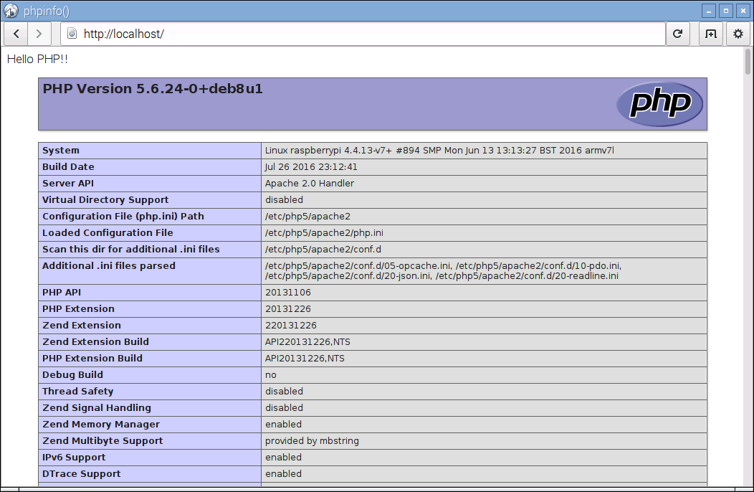
"Hello PHP"

Slide 2
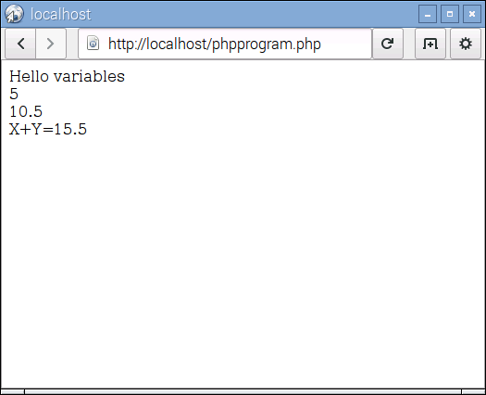
"PHP program"

Slide 3
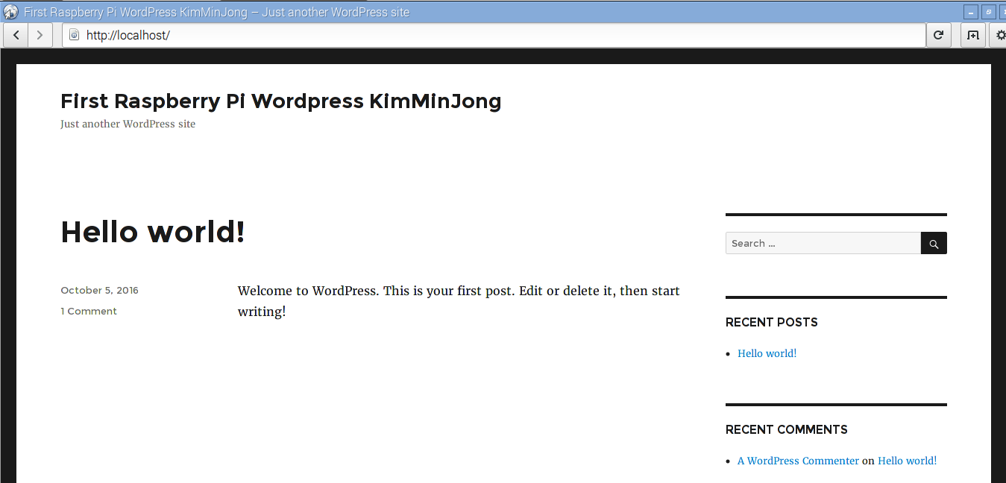
“MY WORDPRESS"

